Slide 1

Stacklite: Stack Overflow Tag Prediction
Under the Guidance of
Guide Name:A.Rajashekar Reddy
Designation:Assistant Professor
Team:
16WH1A1211-Ch.Ramya
16WH1A1217-G.Shrenika
16WH1A1218-G.V.Samhitha
16WH1A1260-Ch.Urmila

Slide 2
Contents
Introduction
Problem Definition
Literature Survey
Existing System
Proposed System
Architecture Diagram
Implementation
Plan of Action
References

Slide 3
Introduction
Largest most trusted online community for developers to learn, share their programming language.
The website serves as a platform for users to ask and answer questions, to vote questions and answers up or down.
Launched on September 15, 2008.
Users will have privileges like the ability to vote ,comment and even edit other people’s posts.

Slide 4
Problem Definition
The questions on stack overflow cover a wide range of topics and are categorized using appropriate tags.
Currently the tags are entered manually by users depending on the questions they have posted.

Slide 5
Literature Survey
Enhancing user experience is more important.
Information provided should be relevant to users.
Concept of tagging.
Vast data - Text classification – Multi-class or Multi-label classification.

Slide 6
Existing System & Proposed System
Existing System
Stack overflow – Popular question answering system.
Developers enter questions and also add related tags before posting a question.
Here user manually enters tags related to the question they post.
Proposed System
Auto tagging system.
Grouping questions about common topics together.
Showing users posts related to a question they are posting on the website.

Slide 7
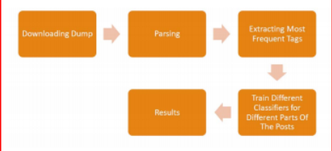
Architecture Diagram

Slide 8
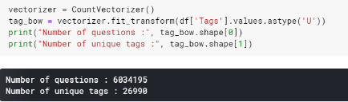
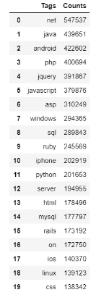
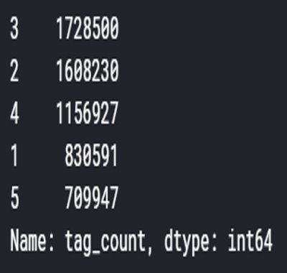
Analysis on Complete Data

Slide 9
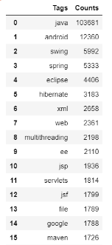


Analysis on 100000 Records

Slide 10
Data Pre-processing
data["Title"] + data["Body"] = data["question"]
Removing stopwords => using Stopwords method from nltk library.
Performing stemming => using SnowballStemmer method from nltk library.
Eg:- “chocolates”, “chocolatey”, “choco” => “chocolate”

Slide 11
Example :-
Data before processing :-
Data["Title"] => "How to check if an uploaded file is an image without mime type?"
Data["Body"] => "I'd like to check if an uploaded file is an image file (e.g png, jpg, jpeg, gif, bmp) or another file. The problem is that I'm using Uploadify to upload the files, which changes the mime type and gives a 'text/octal' or something as the mime type, no matter which file type you upload. Is there a way to check if the uploaded file is an image apart from checking the file extension using PHP?\"
Data["Tags"] => "php image-processing file-upload upload mime-types"
Data after processing :-
Data["question"] => "check upload file image mime type check upload file image file png jpg jpeg gif bmp another file problem uploadify upload file change mime type give text octal some mime type file type upload check upload file image check file php"

Slide 12
Implementation
Count Vectorizer:
Used to count the number of unique tags.
Provides a simple way to both tokenize and build a vocabulary of known words.
TF-IDF Vectorizer:
To find the maximum repeated words.
Offset by the number of documents in the corpus that contain the word.

Slide 13
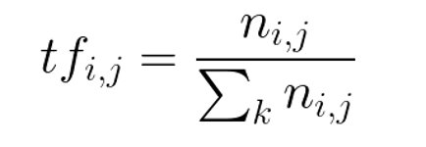
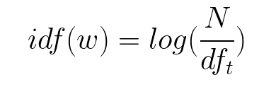
Term Frequency (TF):
The number of times a word appears in a document divided by the total number of words in the document. Every document has its own term frequency..
Inverse Document Frequency (IDF):
The log of the number of documents divided by the number of documents that contain the word. Inverse document frequency determines the weight of rare words across all documents in the corpus.

Slide 14
Problem Transformation Techniques
In this method, we will try to transform our multi-label problem into single-label problem.
This method can be carried out in three different ways as:
Binary Relevance
Classifier Chains
Label Powerset

Slide 15
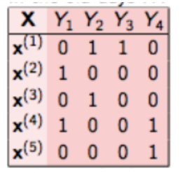
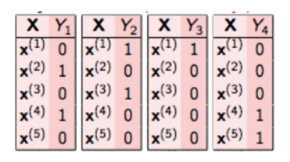
Binary Relevance
This is the simplest technique, which basically treats each label as a separate single class classification problem.
=>
Accuracy :-
33%
Drawback :-
it doesn’t consider labels correlation because it treats every target variable independently.

Slide 16
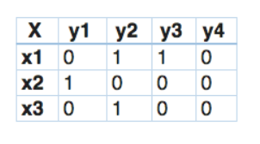
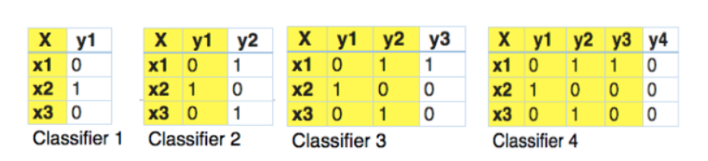
Classifier Chains
In this, the first classifier is trained just on the input data and then each next classifier is trained on the input space
=>
Accuracy :-
42%
Drawback :-
it doesn’t consider labels correlation if data is huge.

Slide 17
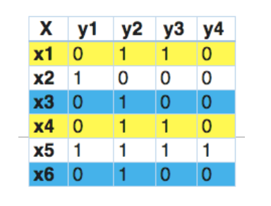
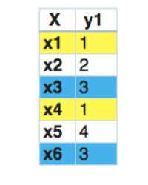
Label Powerset
In this, we transform the problem into a multi-class problem with one multi-class classifier is trained on all unique label combinations found in the training data.
=>
Accuracy :-
57%
Drawback :-
As the training data increases, number of classes become more. Thus, increasing the model complexity, and would result in a lower accuracy.

Slide 18
Adapted Algorithms
Adapted algorithm, as the name suggests, adapting the algorithm to directly perform multi-label classification, rather than transforming the problem into different subsets of problems.
This method can be carried out in different ways as:
K – Nearest Neighbours (kNN)
Logistic Regression

Slide 19


K – Nearest Neighbors (KNN)
Here we would like to capture the relationship between different training samples we obtained.
This relation is found by using Euclidean distance.
It performs 2 steps :
It runs through the whole dataset computing d between x and each training observation.
It then estimates the conditional probability for each class, that is, the fraction of points in A with that given class label.
Accuracy :-
51.5%
Disadvantage :-
The cost of calculating the distance between the new point and each existing points is huge which degrades the performance of the algorithm.

Slide 20
One-vs-Rest
Logistic Regression
Logistic regressions are only binary classifiers.
They cannot handle target vectors with more than two classes.
This can be achieved using One-vs-Rest Classification.
Say we have a classification problem and there are N distinct classes.
One-vs-all classification is a method which involves training N distinct binary classifiers.
Then those N classifiers are collectively used for multi-class classification.
Accuracy :-
81.9%

Slide 21
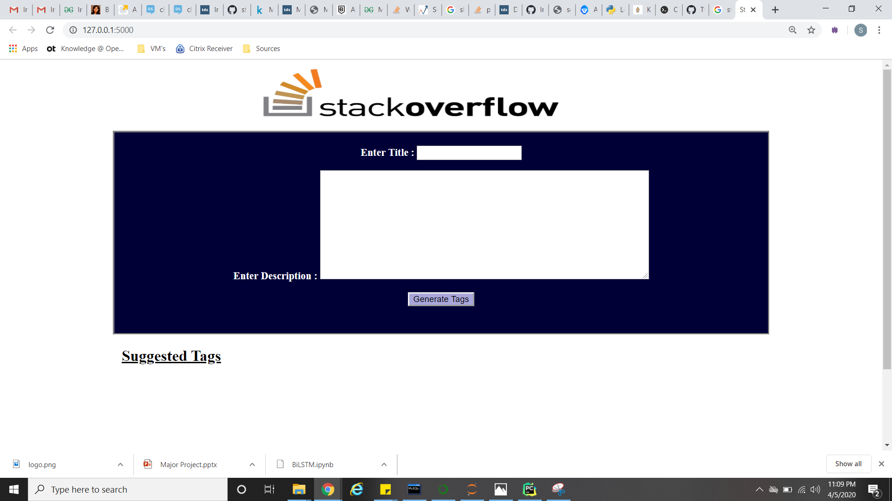
Simple Web Application for validation

Slide 22
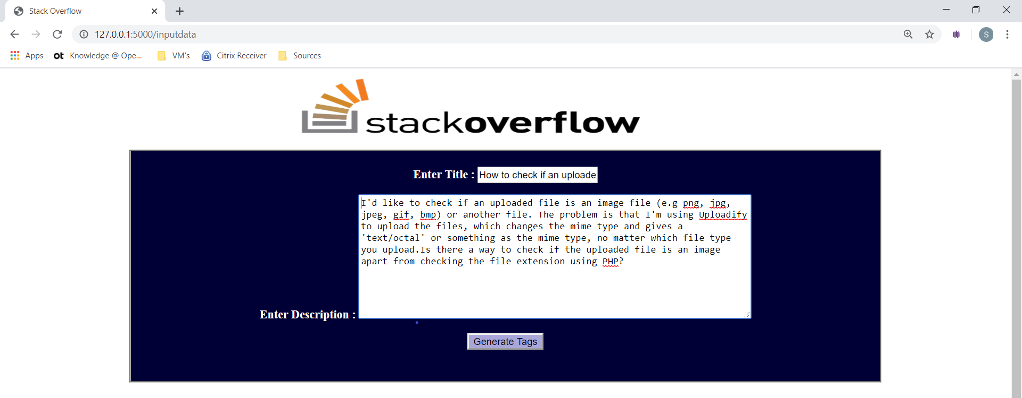
Input

Slide 23
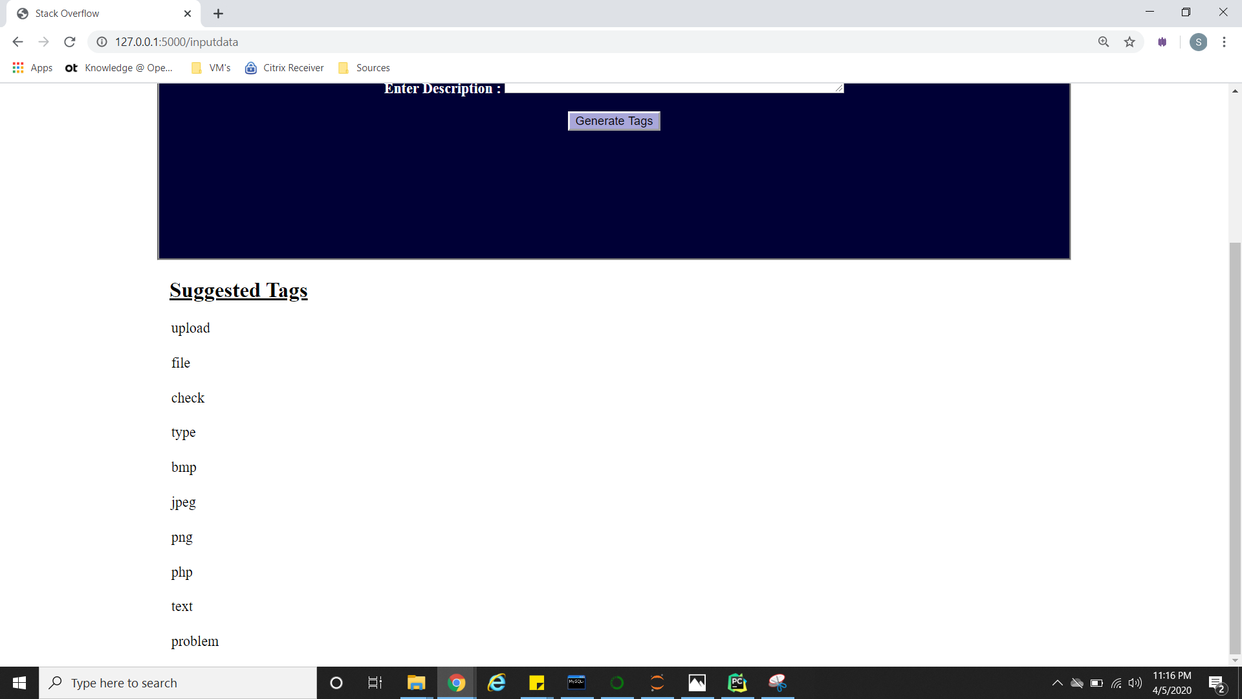
Output

Slide 24
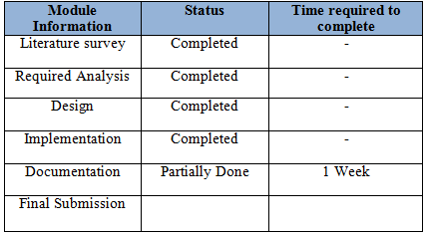
Plan of Action
Completed
-

Slide 25
References
Taniya Saini, Sachin Tripathi, Predicting Tags for Stack Overflow Questions Using Different Classifiers, 4th Int’l Conf. on Recent Advances in Information Technology | RAIT-2018 |.
https://en.wikipedia.org/wiki/Logistic_regression.
https://towardsdatascience.com/logistic-regression-detailed-overview-46c4da4303bc.
https://machinelearningmastery.com/logistic-regression-for-machine-learning/
https://scikit-learn.org/stable/modules/generated/sklearn.linear_model.LogisticRegression.html
https://en.wikipedia.org/wiki/Multi-]https://towardsdatascience.com/stochastic-gradient-descent-clearly-explained-53d239905d31label_classification
https://www.analyticsvidhya.com/blog/2017/08/introduction-to-multi-label-classification/

Slide 26


